Slide 1










































Probabilistic Color-by-Numbers: Suggesting Pattern Colorizations Using Factor Graphs
Sharon Lin, Daniel Ritchie, Matthew Fisher, Pat Hanrahan

Slide 2

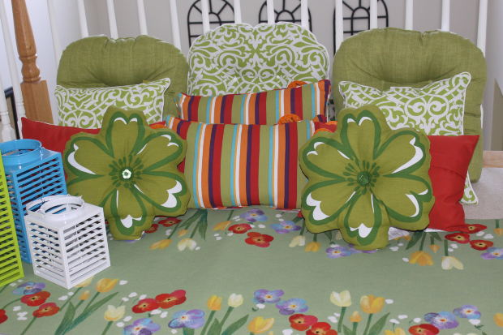
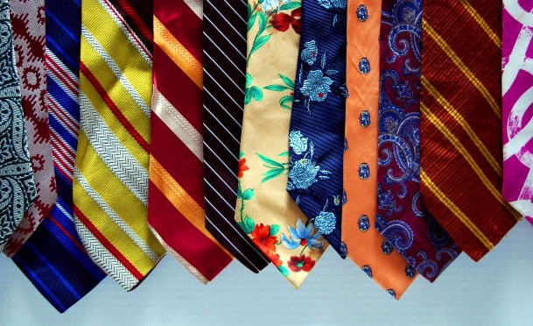
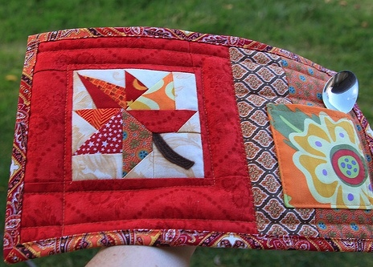
Colored Patterns Are Everywhere
Flickr: Rowena of the Rants
Notes:
Colored patterns are used everywhere to enliven and personalize our surroundings. <C> They appear in web design <C> interior decorations <C> clothing <C> and personal arts and crafts. However, while designing these patterns is difficult,

Slide 3





Coloring Patterns Can Be Challenging
Hard to mentally visualize coloring
Template by COLOURLover Any Palacios
Notes:
even choosing colors for a pattern can be challenging.
One reason is that it can be hard to visualize what a coloring will look like.
For example,
<C> Let’s say I want to color in this pattern. I like nice cool-colored patterns, and start out with …Cool-colroed but looked better in my head.
<C> To fix this, make a series of tweaks..Darkening the blue to make the foreground stand out more…
<C> Tweaking the pink to be less strong..
<C>Now I’m stuck…Looks ok, but not quite what I want and not sure what to do
<C>There is actually a nice mellower coloring a few tweaks away that I like better. However, I may not know how to get there.

Slide 4




Coloring Patterns Can Be Challenging
Difficult to explore other options
Such as:
Notes:
By making local tweaks, it can also be difficult to explore other farther away, but also interesting options. <C> Such as these warmer colored patterns. The gold one is particularly nice, and not something I thought of. How can we better explore the coloring space? Could we have a computational tool help us out?

Slide 5





Suggest Pattern Colorizations to Facilitate the Process
User preferences
?
Input Template
Output Suggested Colorings
Notes:
In this project, we focus on suggesting pattern colorizations to facilitate the coloring process. We want a system that:
<C> Takes an input pattern template. Where in this example, each different gray level indicate a unique color that can appear in the pattern.
<C> The system should take any user preferences on types of colorings
<C> And output a set of appealing colorings of the input

Slide 6
Suggest Pattern Colorizations to Facilitate the Process
User preferences
Suggest diverse colorings
Allow refinement
Accommodate stylistic preferences
?
Input Template
Output Suggested Colorings
Notes:
In particular, the system should be able to suggest diverse colorings for users who are uncertain about their preferences, allow users to refine suggestions, as well as accommodate different stylistic preferences. For example, I may like cooler-colored patterns, but my friend may like warmer-colored patterns.
So, what do we mean by “pattern template”?

Slide 7
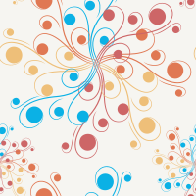
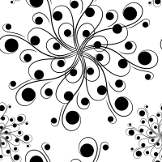




Pattern Template Anatomy
Colored Template
Color Groups
COLOURLovers Nickity Split & ivy21
Notes:
In this project we focus on patterns, such as the one on the left. A pattern template specifies a number of “color groups” which are spatial regions that must map to the same color. For example, one color group is the white background in the colored template. Another color group corresponds to the red regions. And so forth, for the other three colors. Changing the colors of these groups will recolor the template.
We can author these templates from existing colored patterns, vector art, or other types of segmented images.

Slide 8
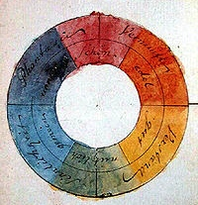
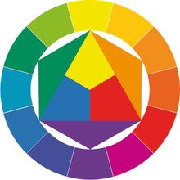
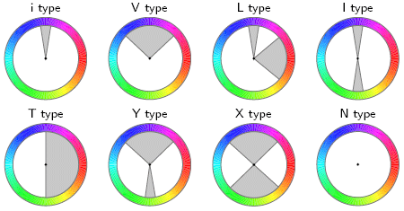
Related Work: Color Compatibility
What combinations of colors do people find appealing?
(Goethe 1810; Itten 1974; Matsuda 1995; Cohen-Or et Al 2006)
Notes:
Related work has focused on color compatibility. Color compatibility is a classic problem, where people have developed systems and theories to predict what combinations of colors people find appealing.

Slide 9
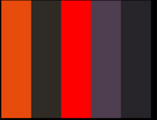

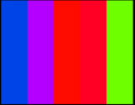
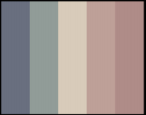
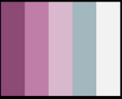
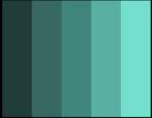
Related Work: Color Compatibility
What combinations of colors do people find appealing?
Low compatibility
High compatibility
(O’Donovan et al. 2011)
Notes:
More recently, O’Donovan et al. analyzed online theme datasets and their ratings. They introduce a regression model to quantify the compatibility of 1D color themes. This model can be used to detect and generate appealing color themes.

Slide 10




Color Compatibility for Patterns
Need to take into account 2D arrangement
3.75
3.74
3.70
3.67
leaves blending into background
“loud” background
What about personal preferences?
Template by COLOURLover jilbert
Notes:
However, when it comes to coloring in patterns, color compatibility should also take into account 2D spatial arrangement. <C> For example, these are some highly rated color themes, which look good as 1D themes. <C> However, when applied to 2D patterns, they can create some controversial colorings, such as foreground blending into background and backgrounds being “loud” or overly saturated.
<C> Finally, people may have different preferences for coloring style. Some may like bolder colorings or ones with more delicate contrast. How can we learn how to make good pattern colorings, while also taking personal preferences into account?

Slide 11




Look at Examples for Guidance
COLOURLovers AlineDam, Any Palacios, wondercake, bhsav
Notes:
One option, and the one we take, is to look at examples of desired colorings for guidance. There are many nice patterns available on the web, showing different combinations of colors and which are used as backgrounds, and which are used next to each other, and so on. By simulating similar properties, we may be able to generate appealing pattern colorings.

Slide 12
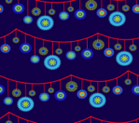











Example-Based Color Suggestion
Examples
…
(optional)
user constraints
Model
Suggester
Input Template
Output Suggested Colorings
COLOURLovers AlineDam, Any Palacios, wondercake, bhsav
Notes:
Here is what our pipeline looks like. Given an input pattern template, a set of colored pattern examples, and optional user constraints, the system learns a model to predict which colorings of the template are more desired. Using this model, the system suggests a set of diverse colorings.
Since the system learns properties of desired colorings from examples, (next slide)

Slide 13













Can Change Style Based on Examples
Examples
…
(optional)
user constraints
Model
Suggester
Input Template
Output Suggested Colorings
COLOURLovers AlineDam, Any Palacios, praxicalidocious, bhsav
Notes:
we can change the style of the suggested colorings by changing the set of examples. For example, if I like dark and glowing colorings I can provide a set of such examples, to get similar suggested colorings.
In this project, we draw our examples from an online pattern-sharing site: COLOURLovers.

Slide 14
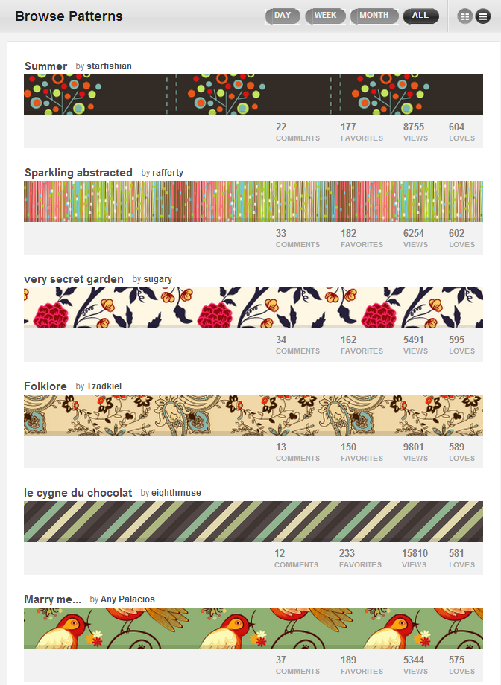
Dataset: COLOURLovers
Many patterns available:
Collected 8200 from 82 artists
For our tests:
Trained on up to 913 patterns
Notes:
There are many colored patterns available, from different artists. We were able to collect 8200 patterns from the top 82 artists, though many more exist.
For our experiments, we trained models on up to 913 of these patterns.
Using these examples, we can now learn how to suggest good colorings.

Slide 15
model
Notes:
In order to do so, we must have a way to quantify the goodness of a coloring. Here, we’ll give an overview of our model.

Slide 16
Scoring a Coloring
Unary Factors
Notes:
<C> To illustrate how the model works, let’s take this pattern template as an example. We want a good coloring of this template. There are different factors that might contribute to a good coloring. The simplest is to just consider each color group in the pattern and its assigned color individually. For this, we insert scoring functions over each group, <C> or unary factors, that score how well individual colors fit each region.

Slide 17



Scoring a Coloring
Good
Notes:
For example, if we assign the flower group this mellow red color, the unary factor on this group might consider this a good color for this region. <C> How do we determine if this color is good? If we look at our pattern examples, similarly shaped regions are colored in a similar red, so it is likely that this color is appropriate.

Slide 18
Scoring a Coloring
?
?
Poor
?
Notes:
On the other hand, a bright neon green might be a poor choice for this region. Few examples in our dataset use this type of neon color in the foreground.

Slide 19
Scoring a Coloring
Notes:
So, our model so far has unary factors that consider the goodness of individual colors. However, this is not enough.

Slide 20
Scoring a Coloring
Notes:
In this case, we color both the foreground and background in a similar mellow red.

Slide 21
Scoring a Coloring
Notes:
Our unary factors think that it’s a good coloring because the colors are good individually. However, we can barely separate the pattern regions. Thus, our model needs a bit more sophistication.

Slide 22
Scoring a Coloring
Pairwise
Factors
Notes:
We add additional scoring functions, or pairwise factors, over adjacent color groups. These score how well two combined colors fit each set of adjacent regions.

Slide 23
Scoring a Coloring
Notes:
Using these pairwise factors, we can detect that this combination of similar colors is poor.

Slide 24
Scoring a Coloring
Global Color Compatibility
[O’Donovan et al. 2011]
Color Theme:
Notes:
Finally, we may want to consider colors more globally as well. Here both individual colors and pairwise adjacent colors look reasonable, but as a whole, the color theme of this pattern may look a bit off. <C> We include a global color compatibility term to score the color theme of the pattern. <C> Here, we use the color compatibility model introduced by O’Donovan and colleagues.

Slide 25
Scoring a Coloring
Global Color Compatibility
[O’Donovan et al. 2011]
Color Theme:
Notes:
We could now improve the color theme of the coloring

Slide 26
Scoring a Coloring
Color Theme:
Notes:
Like so...to find a coloring that is scored highly by the factors overall.

Slide 27
Scoring a Coloring
Notes:
Our final model includes factors that consider individual colors, adjacent colors, and the global color theme of a pattern. To illustrate what some of these factors look like, my co-author Daniel will describe the <C> unary factors in more detail..

Slide 28
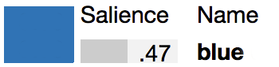
Modeling Unary Color Factors
Property of Region’s Color
Features of Region’s Shape
Lightness
Saturation
Name Saliency [Heer & Stone 2012]
…
Notes:
Unary color factor scores the goodness of a single color in the pattern
<C> Going to do this probabilistically. Given our training examples, how likely is this color, given shape features of the region the color is assigned to?
<C> To make the model more generalizable, rather than modeling this distribution for the color directly, we model it for several key properties of the color
Such as
Lightness
Saturation
Name saliency: a measure of how reliably a color is named and reflects how “instantly recognizable” the color is.

Slide 29
Modeling Unary Color Factors
Property of Region’s Color
Features of Region’s Shape
Size
Elongation
Centrality
…
Notes:
The shape features we condition on include
the relative size of the region
how elongated or square the region is
and how centrally located it is.

Slide 30





Learning Factor Distributions
Learner
Saturation
Size
0.2
0.7
0.4
=
Predictor
Elongation
Centrality
…
=
Distribution
0.8
0.92
Notes:
So how can we learn this distributions from examples, and then use them to score color assignments?
<C> Suppose we’re learning distributions for saturation.
<C> We’d like to feed in our example patterns…
<C> …and obtain a predictor that…
<C> …given a particular shape feature vector…
<C> …can output a distribution over expected saturation values for a region of that shape
<C> We can then query this distribution with specific saturation values and get back a probability, or score.

Slide 31
Learning Factor Distributions
0
1
Lightness
Notes:
Now that we’ve seen the overview of how the learning process ought to work, let’s take a look at how we actually implemented it.
Suppose we’re trying to learn distributions for lightness.

Slide 32



Learning Factor Distributions
0.1
0.2
0.7
…
0.4
0.1
0.5
0.2
0.1
0.4
0.1
0.1
0.9
0
1
2
3
4
5
6
7
8
9
Lightness
Notes:
First, we discretize the range of possible lightness values into bins.
<C> Next, let’s take a look at our example patterns.
<C> For each region, we extract the shape feature vector for that region, as well as the lightness value of its color.

Slide 33
Learning Factor Distributions
0.1
0.2
0.7
…
0.4
0.1
0.5
0.2
0.1
0.4
0.1
0.1
0.9
0
1
2
3
4
5
6
7
8
9
Lightness
Notes:
For this region…
<C> …the lightness value falls into this bin…

Slide 34
Learning Factor Distributions
1
0.2
0.7
…
0.4
0.1
0.5
0.2
0.1
0.4
0.1
0.1
0.9
0
1
2
3
4
5
6
7
8
9
Lightness
Notes:
…so we’ll say that this region has discrete lightness value 1

Slide 35
Learning Factor Distributions
1
0.2
0.7
…
0.4
0.1
0.5
0.2
0.1
0.4
0.1
0.1
0.9
0
1
2
3
4
5
6
7
8
9
Lightness
Notes:
Similarly, this region…

Slide 36
Learning Factor Distributions
1
2
0.7
…
0.4
0.1
0.5
0.2
0.1
0.4
0.1
0.1
0.9
0
1
2
3
4
5
6
7
8
9
Lightness
Notes:
…has lightness value 2.

Slide 37
Learning Factor Distributions
1
2
0.7
…
0.4
0.1
0.5
0.2
0.1
0.4
0.1
0.1
0.9
0
1
2
3
4
5
6
7
8
9
Lightness
Notes:
And here

Slide 38
Learning Factor Distributions
1
2
7
…
0.4
0.1
0.5
0.2
0.1
0.4
0.1
0.1
0.9
0
1
2
3
4
5
6
7
8
9
Lightness
Notes:
We have lightness value 7

Slide 39

Learning Factor Distributions
1
2
7
…
0.4
0.1
0.5
0.2
0.1
0.4
0.1
0.1
0.9
?
0.2
0.7
0.4
Classifier
1
0
0
1
2
3
4
5
6
7
8
9
Lightness
Notes:
Now we’ve reduced our examples into pairs of a discrete lightness value, followed by a shape feature vector.
<C> This kind of data can be used to train a classifier that can predict, given a feature vector, what bin its lightness value should fall into.
<C> So, given an uncolored pattern template (which has known shape features but unknown lightness)…
<C>…we can have classifier to predict, for any given region, the probability that it’s lightness value falls into each bin. This forms a histogram..

Slide 40
Learning Factor Distributions
1
2
7
…
0.4
0.1
0.5
0.2
0.1
0.4
0.1
0.1
0.9
?
0.2
0.7
0.4
Classifier
1
0
1
0
Lightness
Notes:
<C> …which we convolve with a Gaussian kernel to recover a continuous probability distribution. This finally, is the distribution we use for scoring.

Slide 41
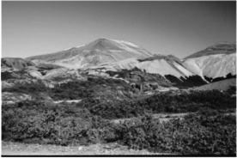
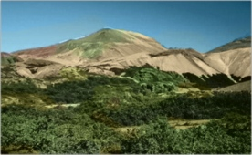
Learning Factor Distributions
1
2
7
…
0.4
0.1
0.5
0.2
0.1
0.4
0.1
0.1
0.9
?
0.2
0.7
0.4
Classifier
1
[Charpiat et al. 2008]
0
1
0
1
Lightness
Notes:
<C> The basic idea of histogram estimation and smoothing was inspired by recent work in grayscale image colorization, which predicted distributions over colors given local texture descriptors in an image.

Slide 42
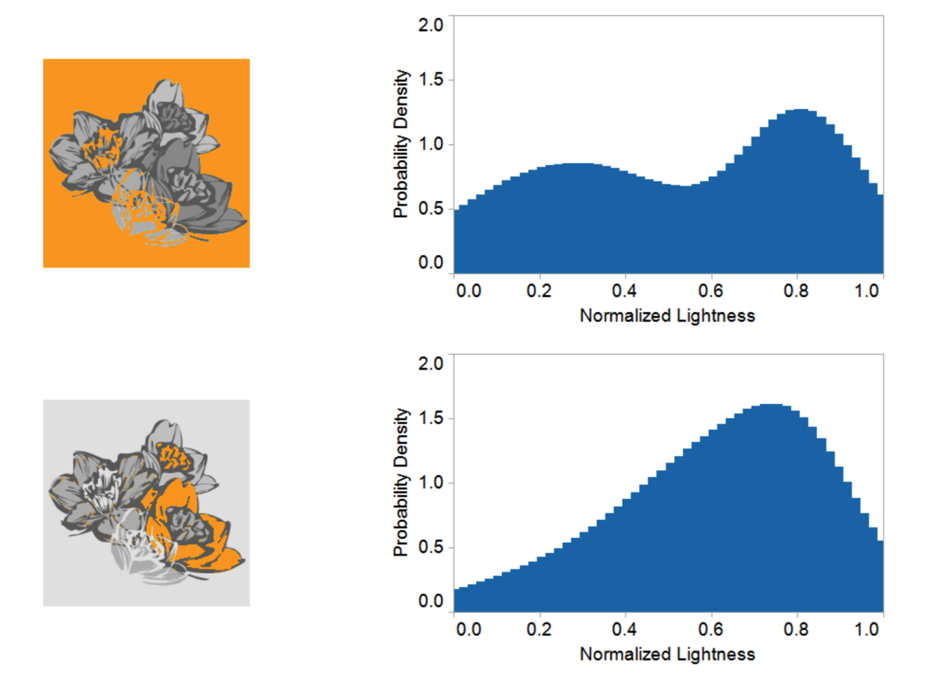
Example Learned Factors
Notes:
Here are two examples of learned lightness distributions, where the pattern region whose probability is being visualized is colored in orange.
<C> Notice that for the large region in the top example, the predicted distribution over lightness values is bimodal, which mirrors our intuition that pattern backgrounds are usually either light or dark, but not of middling intensities.
The ability to capture this sort of phenomenon is a major advantage of our representation over simpler models such as linear Gaussians.

Slide 43
Scoring a Coloring (Revisited)
Pairwise
Factors
Unary Factors
Global Color Compatibility
[O’Donovan et al. 2011]
Notes:
Jumping back up to our model overview…
<C> We’ve just seen how the unary factors are implemented…
<C> …The pairwise factors are implemented using the same learning framework…
<C>…and as Sharon already mentioned, the global compatibility factor uses the model developed by O’Donovan and colleagues

Slide 44
Scoring a Coloring (Revisited)
Score = Product of Factors
(Factor Graph)
Notes:
<C> Then, the overall score of a pattern coloring is the product of all of these factors.
<C> This forms a type of probabilistic model know as a factor graph, and if you go the “Laplacians, Light Fields, and Layouts” session on Thursday, you’ll hear about another computational design project that also uses factor graphs.
The precise math behind this formalism, as well as the algorithm we use to tune the relative weights of each factor, can be found in the paper.

Slide 45






Generating Coloring Suggestions
Metropolis Hastings (MH)
Parallel Tempering
Maximum Marginal Relevance
REJECT
ACCEPT
ACCEPT
Notes:
Ok, so we can compute the score of an given pattern coloring – now how do we actually generate high-scoring colorings to suggest to the user?
<C> To do this, we turn to the Metropolis Hastings algorithm to approximately sample from the distribution encoded by our factor graph.
<C> MH moves through the coloring state space by perturbing colors, or by swapping the colors of two different regions.
<C> To avoid getting stuck in local minima, we use parallel tempering, which runs multiple MH chains in parallel and periodically swaps their states.
<C> And finally, to suggest a diverse set of colorings, we return the top N samples according to the Maximum Marginal Relevance criterion, which balances score against variety.

Slide 46
RESULTS
Notes:
Alright, so let’s take a look at some results

Slide 47

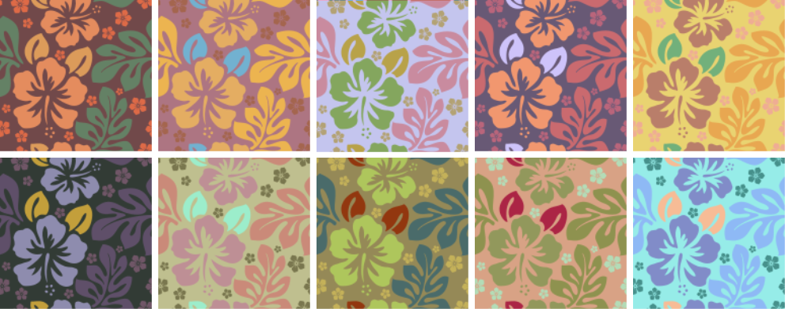

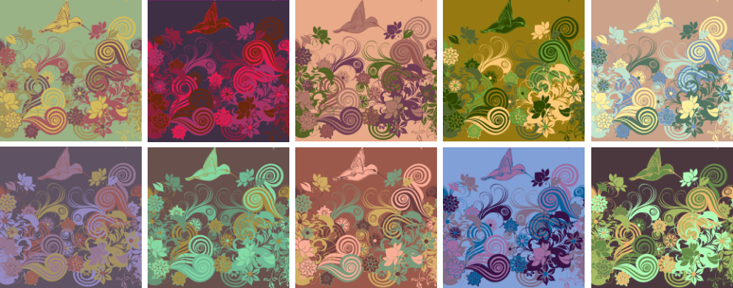
Exploratory Suggestions
Notes:
Early in the creative process, our system can suggest a variety of possible colorings to help people explore the space of possibilities.
<C> Given these two initial, uncolored pattern templates…
<C> …these are 10 suggested colorings from our system. The suggestions have a wide variety of styles, ranging from light to dark, and from bold to more muted.

Slide 48




Refinement: Nearby Colorings
Notes:
When someone has an idea as to the coloring they’re looking for, our system can help them refine it.
<C> Given initial colorings of a pattern template …
<C> …here are four re-colorings obtained by adding an additional factor encouraging each region to take a color similar to its initial color
This ‘soft constraint’ allows all colors in the pattern to vary but prevents them from wandering too far from the desired range.

Slide 49
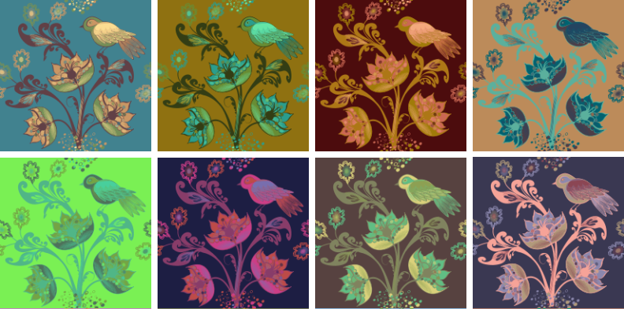
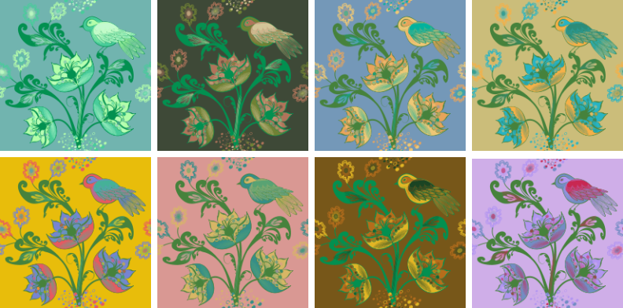
Refinement: Hard Constraints
Unconstrained
Flower Stem Color =
Notes:
Alternatively, someone might know exactly what color a particular pattern region should be, but not have an idea about the rest of the image.
<C> Here are 8 colorings of a bird-and-flowers template generated freely, without any constraints.
<C> If I’m sure that I want the flower stem to be a particular shade of green, then I can fix those regions to be that color, and allow the rest of the colors to vary freely in the suggestion process.
This is a form of conditional probabilistic inference.
Even with the stem color fixed, there’s still a great detail of interesting variety suggested.

Slide 50

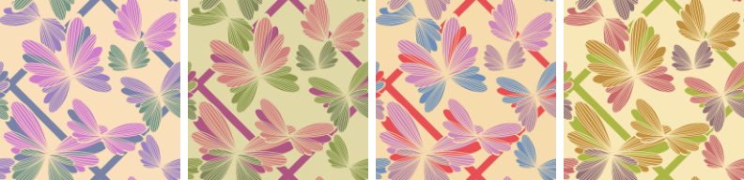





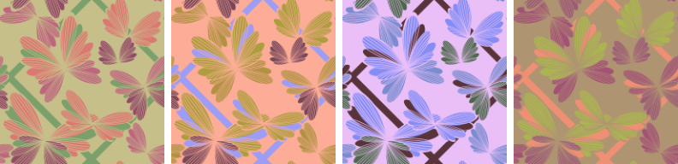
Style Simulation
Light
Dark
Bold
Mellow
Notes:
This system can also capture a particular desired style by manipulating which examples are used for training.
<C> Here, we show one example pattern for each of four styles: light, dark, bold and mellow.
By training on a small set of similar patterns for each style…
<C> … we can generate suggestions such as these, which reflect the salient stylistic properties of their respective examples. Note that no tweaks to the model were required to capture this behavior, other than changing the set input example patterns.

Slide 51



Application: Web Design
Notes:
We applied our recoloring system to a web design problem.
<C> Here, we tried to color the background pattern of a web page to match an already-colored page body.
To do this, we added another factor which encouraged each color to be similar to one of the body colors.
This kind of technology could be useful for automatically re-theming a website according to the season, time of day, or user preferences.

Slide 52
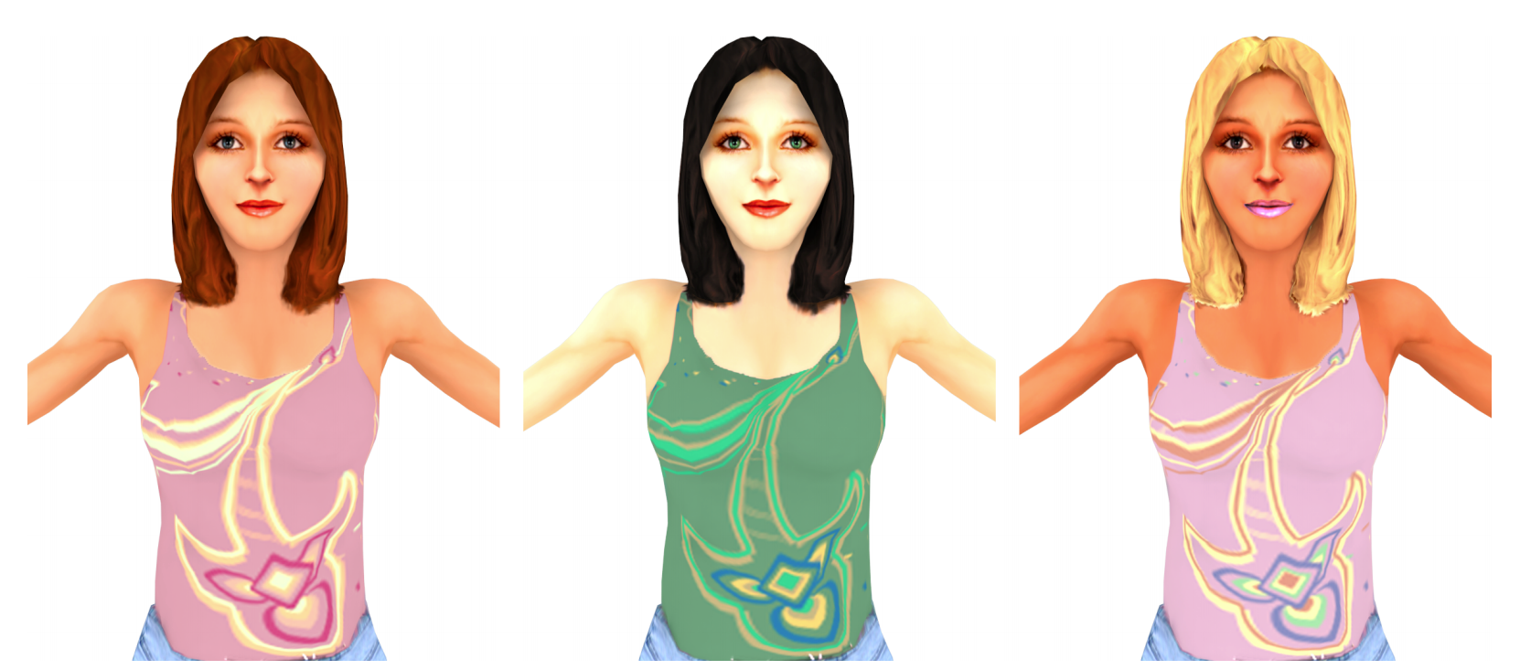
Application: Fashion Design
Notes:
We also applied our system to a clothing design task.
<C> Here, we performed recoloring on this 3d model’s texture atlas, treating the hair, skin, and eye color as fixed colors. The pattern on the shirt was allowed to vary freely to produce coloring that would match.

Slide 53
Evaluation
Notes:
To verify that our system can consistently produce useful colorings, we evaluated it using a judgment study with human participants.

Slide 54
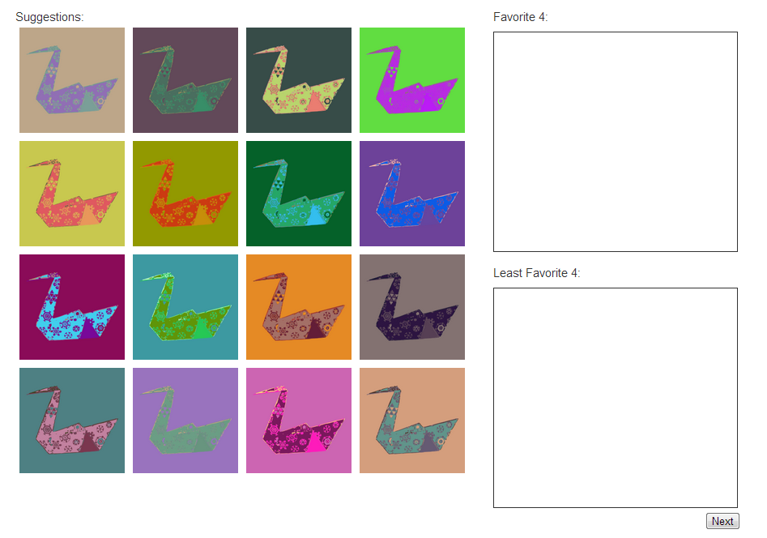
Notes:
Participants were shown an interface containing 16 recolorings of the same pattern.

Slide 55
4 x Uniform Random
4 x Color Compatibility Only
4 x Full Model
4 x Hand-Colored
Notes:
Unbeknownst to them:
4 of these patterns were generated by sampling colors uniformly at random in the RGB color cube
4 were sampled from a model using only global color compatibility
4 were sampled from our full model
and 4 were hand-colored by COLOURlovers artists.

Slide 56




Notes:
Participants were asked to choose their 4 favorite colorings…

Slide 57




Notes:
…as well as their 4 least favorite colorings.

Slide 58
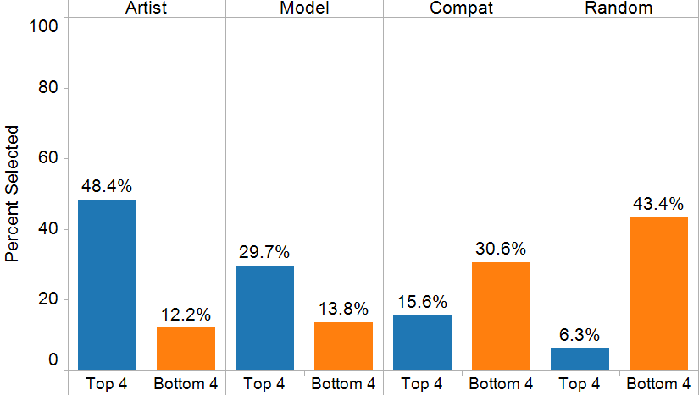
Better Than Other Automatic Methods (but not hand-colored patterns)
Notes:
In examining the results of this study, we first saw
<C>…that people significantly preferred colorings generated by our model to those generated by the other two automatic methods.
<C> In addition, hand-colored patterns were still preferred over those generated by our model. This is expected, and totally acceptable, since we envision this technology being part of an interactive workflow that augments human creativity, rather than replacing it.

Slide 59
People Make ‘Bad’ Colorings Just as Often
Notes:
Along these lines, we also noticed
<C> that between the colorings generated by our model and those done by hand, there was no significant different in the number of patterns that were picked as “least favorites.”
This supports the notion that our system consistently generates colorings that are good enough to spur further creative work and inspiration.

Slide 60
Future work
Notes:
That being said, there’s still a lot of work to be done in this space.

Slide 61



Limitation: Semantics
“sky”
Notes:
Our current system has a few limitations.
For one, it does not know about the semantics of pattern regions.
<C> So for this pattern template…
<C> …it might suggest this coloring, with a pale blue sky…
<C> …but it could also suggest this one, with a non-physically red sky.
This kind of deviation from reality can be artistically desirable, but not in all cases.
<C> In the future, it would be ideal if a user could provide a semantic label, and have that label implicitly constrain the coloring suggestions.

Slide 62
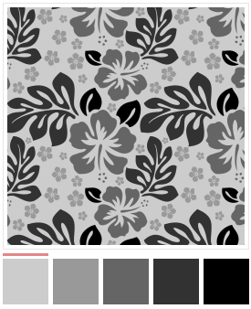

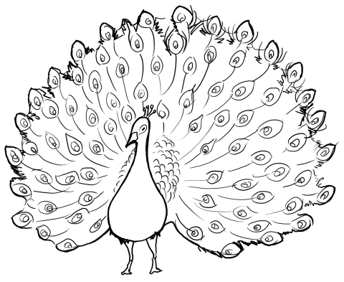
Limitation: Known Color Groups
?
?
1
2
3
4
5
Notes:
In addition, our system is currently restricted to operating on patterns whose color groups are known in advance.
<C> In this pattern template, the system must be told that that all of the black regions should take on the same color.
<C> However, there is a huge variety of interesting, unstructured line art available in the wild, and it would be valuable to enable automated coloring of these kinds of images.
This will require development of higher-order inference algorithms that can jointly determine both the set of color groups and color assignments to those groups.

Slide 63
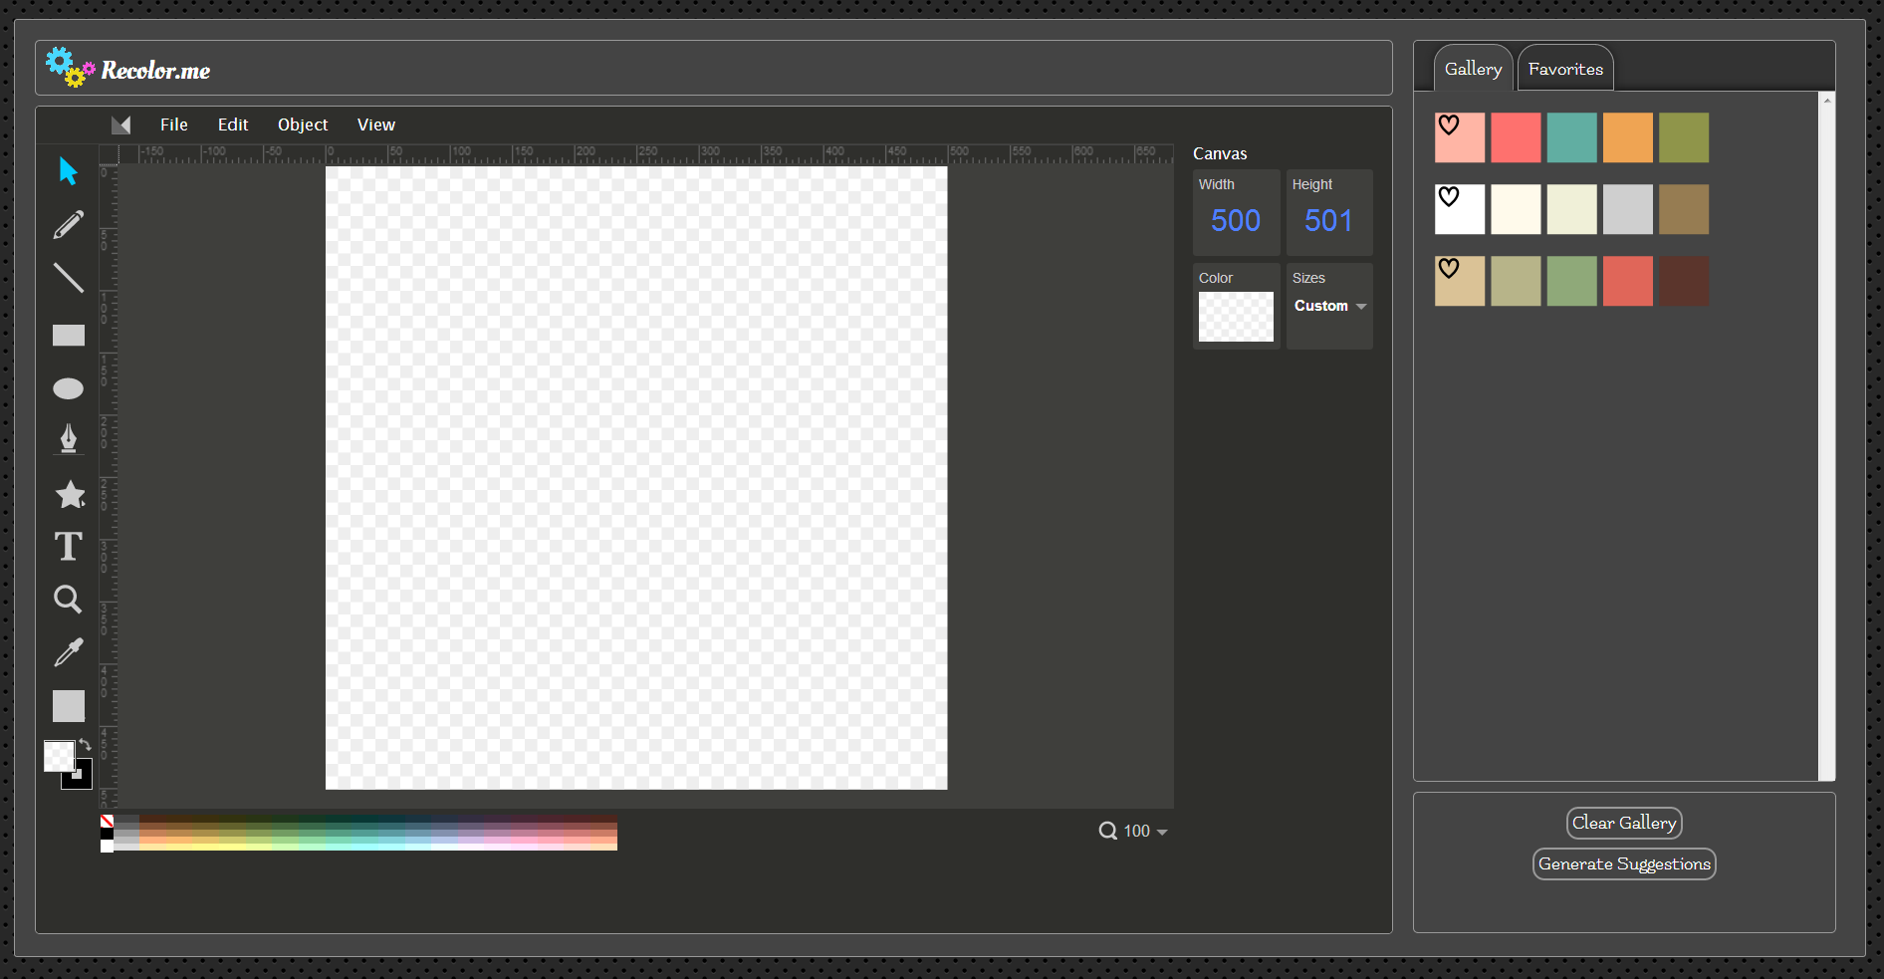





Integration into Interactive Tools
Notes:
And,
<C> we would also like to explore how to integrate the technology developed in this work into interactive graphic editing tools and artist workflows.

Slide 64
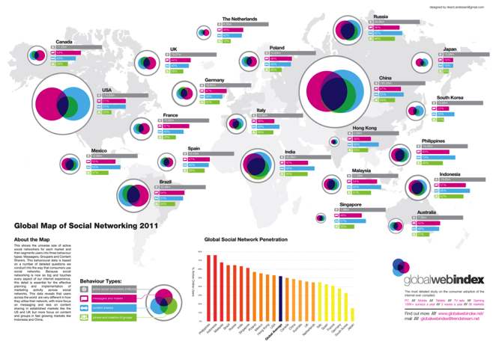




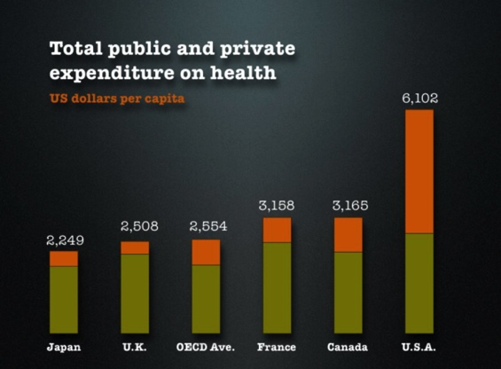
Looking Forward
Notes:
Finally, in looking toward the future, we believe that automatic pattern coloring is really just the tip of a very large and fascinating research iceberg.
<C> After all, color choice is just one of many important attributes in visual design.
Other critical factors include layout, typography, and choice of marks in data visualization.
The probabilistic framework developed in this work is very general-purpose, and we believe that similar methods could be fruitfully applied to these areas.
Ultimately, we envision a future of ‘computational visual design,’ where probabilistic suggestion engines work in tandem with people to create more communicative, more evocative, and more beautiful graphical artifacts.

Slide 65
Thanks!
Support for this research provided by:
Intel (ISTC-VC)
SAP (Stanford Graduate Fellowship)
Notes:
And that concludes the talk. Thanks for your attention.

